Slide 1
Stationery Inventory Management System
CB23F35 · LOW-CODE APPLICATION DEVELOPMENT
A stock, purchasing and approval application built on Zoho Creator
Jayaraman S · 2116240701210
B.E. Computer Science and Engineering, Semester V
· Rajalakshmi Engineering College
Notes:
Introduce the project: a low-code application on Zoho Creator that tracks stationery stock, purchase orders and their approval. Course CB23F35, submitted November 2026.

Slide 2
Manual stock tracking breaks down quickly
THE PROBLEM
01
02
03
Errors build up
Reorders come late
No purchase trail
Balances are worked out by hand in a register or spreadsheet, so arithmetic and data-entry mistakes add up.
Items that reached their reorder level are noticed only when someone finds the shelf empty.
Orders are hard to follow from placement to receipt, and higher-value orders have no structured approval.
Stationery Inventory Management System · CB23F35
2
Notes:
Stationery and office supplies are used every day, and running out of a common item interrupts work. In a small store the stock position is usually kept in a register or spreadsheet, which causes calculation errors, late reorders and no clear record of purchase orders.

Slide 3
One application for stock, orders and approvals
OBJECTIVES AND SCOPE
3
6
Objectives
Link items, transactions and purchase orders
Update stock automatically and block excess Stock Out
Flag low stock and send a daily email alert
Run purchase orders through a Blueprint
Route orders of ₹1,000 or more for approval
Show a dashboard and deploy through three environments
forms linked by lookups
list reports and approval views
1
5
inventory dashboard
Deluge scripts
Stationery Inventory Management System · CB23F35
3
Notes:
Scope: Items, Stock Transaction and Purchase Orders forms; four list reports plus the Pending and Completed Tasks approval views; one Inventory Dashboard; five Deluge scripts DS-01 to DS-05. Two roles: Super Admin and CEO. Web access only. Out of scope: integrations with other services, mobile app, customer portal.

Slide 4
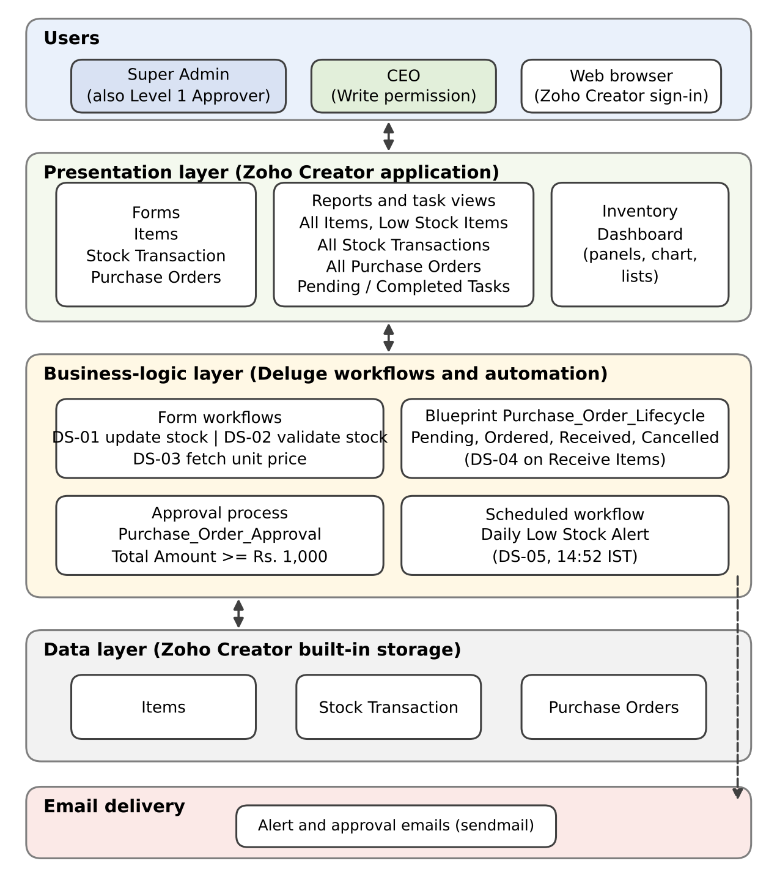
Everything runs on Zoho Creator
SYSTEM DESIGN
Users reach the application in a web browser through a top menu of forms, reports and the dashboard
Deluge scripts, workflows, a Blueprint and an approval process hold the business logic
Three forms store the data: Items, Stock Transaction and Purchase Orders
Stationery Inventory Management System · CB23F35
4
Notes:
The architecture figure from Chapter 4 of the report. There is no separate server, database or deployment pipeline to set up; hosting, role-based access and the release path from Development to Stage to Production come with the platform.

Slide 5
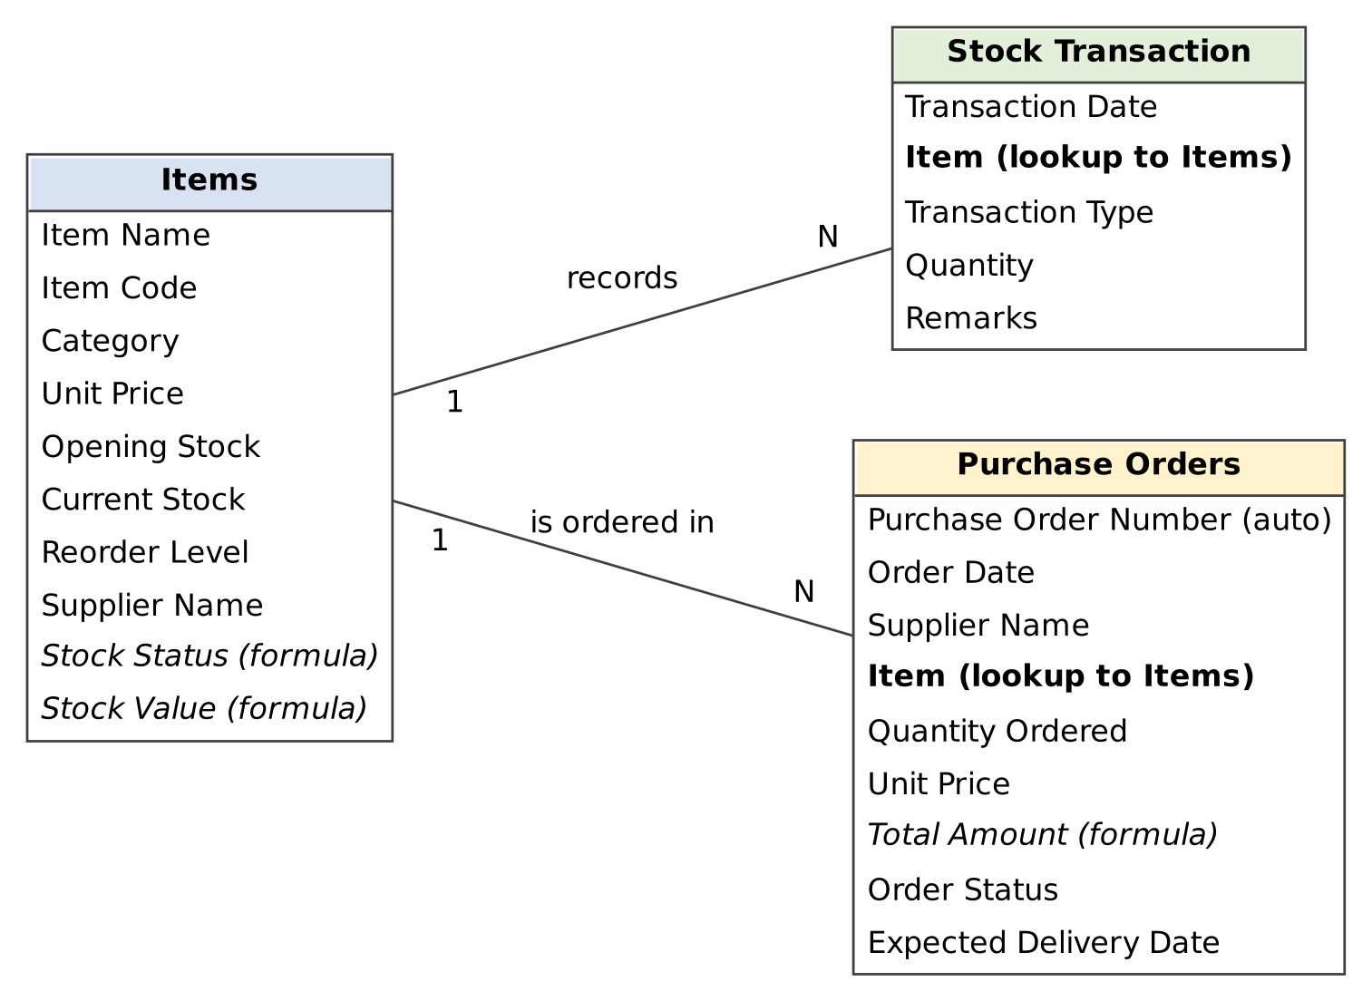
Three forms, linked by one lookup
DATA MODEL
Items holds price, stock and reorder level, with formula fields for Stock Status and Stock Value
Stock Transaction records each Stock In or Stock Out against an item
Purchase Orders picks an item and calculates Total Amount
Stationery Inventory Management System · CB23F35
5
Notes:
The ER diagram from Chapter 4. The Item lookup in Stock Transaction and Purchase Orders is what lets the scripts find and update the right item's Current Stock.

Slide 6
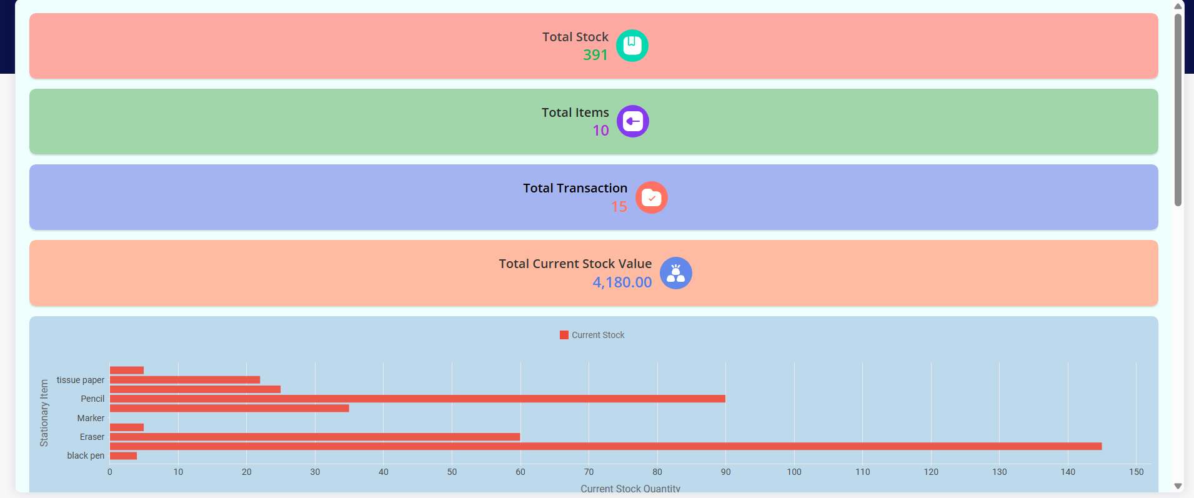
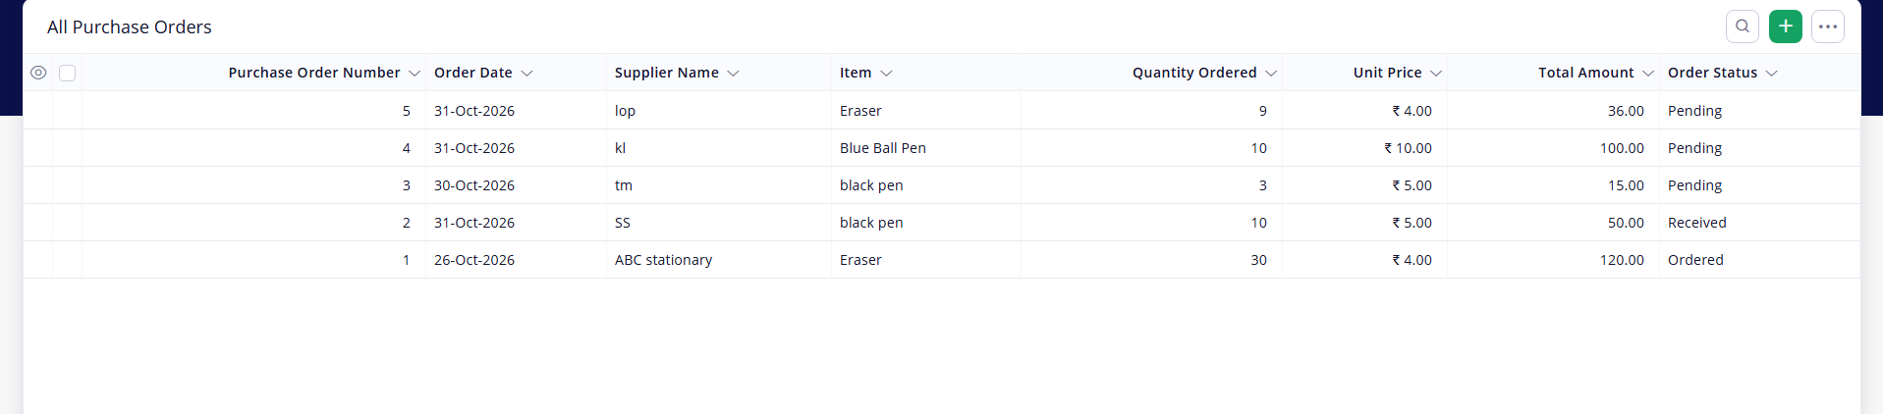
The application at work
IMPLEMENTATION
All Purchase Orders report with order status
Inventory Dashboard: totals and current stock by item
Top menu navigation
4 list reports
2 approval views
Stationery Inventory Management System · CB23F35
6
Notes:
Screenshots from the running application with the header cropped out. The top menu has Items, Approvals, Stock Transactions, Inventory Dashboard and Purchase Orders. The sample data is test data entered by the student. The dashboard chart labels in this screenshot are incomplete; consider retaking it before the final submission.

Slide 7
Five Deluge scripts keep stock correct
AUTOMATION
Script | Where it runs | What it does
DS-01 | Stock Transaction, after submit | Adds or subtracts the quantity in Current Stock
DS-02 | Stock Transaction, validation | Blocks a Stock Out larger than available stock
DS-03 | Purchase Orders, item input | Fills Unit Price from the selected item
DS-04 | Blueprint, Receive Items | Adds the quantity ordered to Current Stock
DS-05 | Schedule, daily at 14:52 IST | Emails items at or below their reorder level
Stationery Inventory Management System · CB23F35
7
Notes:
Complete code is in Appendix C of the report. Example from testing: a Stock Out of 21 reduced Parker pen stock from 25 to 4, which then appeared in Low Stock Items. A Stock Out of 100 against stock of 25 was rejected with an Insufficient stock alert.

Slide 8
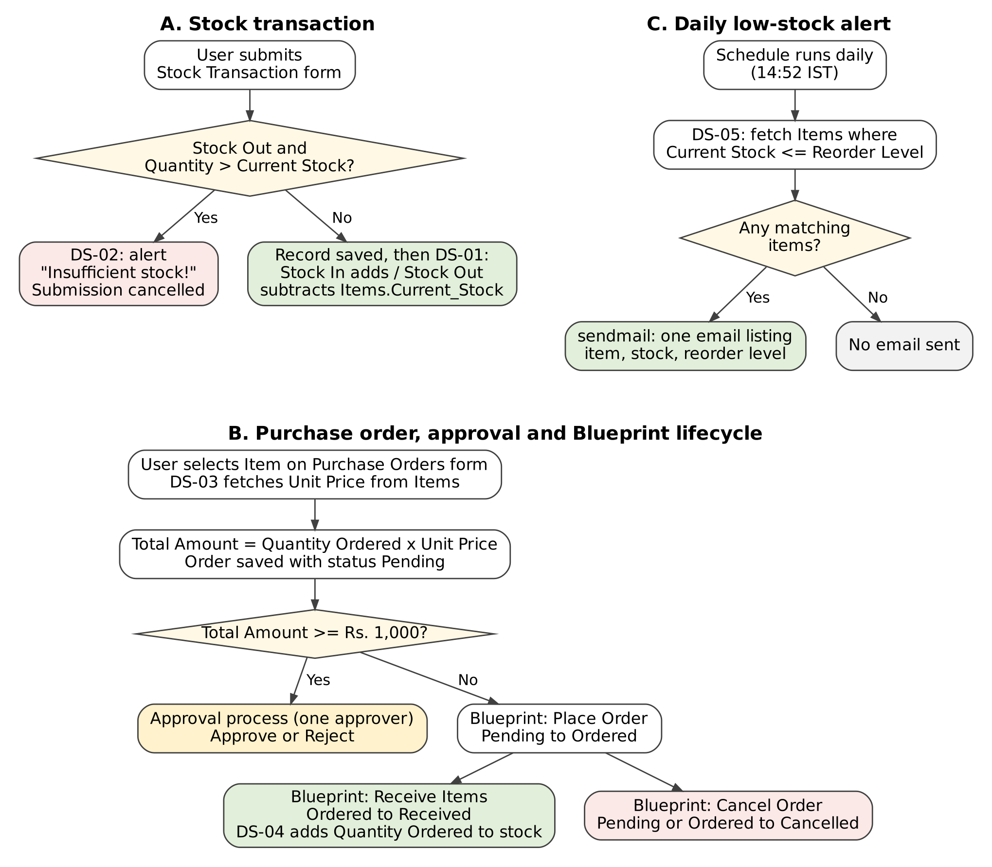
A purchase order moves through set stages
WORKFLOW AND APPROVAL
Blueprint
Pending → Ordered (Place Order) → Received (Receive Items). Cancel Order is allowed from Pending and from Ordered.
Approval process
Orders with Total Amount of ₹1,000 or more go to an approver, who approves or rejects them in Pending Tasks.
Daily alert
A scheduled workflow emails the low-stock items every day.
Stationery Inventory Management System · CB23F35
8
Notes:
The Blueprint is named Purchase_Order_Lifecycle and the approval process Purchase_Order_Approval. Approval was added in version 3.2 of the application. In testing, a ₹1,500 order was routed for approval and approve and reject both worked; the re-test for orders below ₹1,000 is still to be run.

Slide 9
Tested, released and access-controlled
TESTING, DEPLOYMENT, SECURITY
Testing
Deployment
Security
15 of 18
V3.2
2 roles
test cases passed. Three are yet to be run.
Development → Stage → Production, published on 31 October 2026.
Super Admin and CEO, plus stock validation, approval and Blueprint stages.
Stationery Inventory Management System · CB23F35
9
Notes:
Test results are those confirmed by the student in the Development environment; no formal test log or user acceptance sign-off exists. The yet-to-run cases are TC-02, TC-15 and TC-18. The application was published to Stage and Production at version 3.2.

Slide 10
Low-code was enough for this application
CONCLUSION
What was delivered
Limits and next steps
Automatic stock updates and low-stock alerts
A purchase order lifecycle with approval
A dashboard and role-based access
Release through three environments
No integrations, mobile app or portal yet
No formal user acceptance sign-off
Next: weekly digest, stock valuation report, approval status in the order report
Thank you. Questions?
Stationery Inventory Management System · CB23F35
10
Notes:
Forms, lookups, reports, a dashboard, Deluge, a Blueprint, an approval process and a schedule were enough for the whole application. Where low-code stops: integrations, custom UI and mobile access would need more. Future items are those listed as out of scope in Chapter 1.

